Slide 1


Statistics Mean, Median, Mode, Standard Deviation, Normal and Sampling Distribution, and Z-Score
Portland Data Science Group Created by Andrew Ferlitsch Community Outreach Officer July, 2017

Slide 2
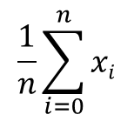
Mean
The mean is the average of a set of samples or a population distribution.
Sum (add) up all the samples
Symbol for mean (mu)
$$\frac{1}{n}\sum_{i=0}^{n}{xi}$$
µ =
Divide the summation by the number of samples
Example:
Samples = { 1, 2, 2.5, 2.5, 3, 3, 3.5 }
1 + 2 + 2.5 + 2.5 + 3 + 3 + 3.5
7
µ = 2.5

Slide 3
Median
The median is the mid-point in a sorted (frequency) distribution of
samples (population).
Odd Number of Samples – is the sample at the midpoint (center)
Even Number of Samples – is the average of the two samples at
the midpoint (center)
Seven Samples = { 1, 2, 2.5, 2.5, 3, 3, 3.5 }
= 2.5
midpoint
Symbol for median
Eight Samples = { 1, 2, 2.5, 2.5, 3, 3, 3.5, 4 }
= ( 2.5 + 3 ) / 2 = 2.75
midpoint

Slide 4
Discrete vs. Continuous
The values of a population can be classified as either discrete or
continuous values.
Discrete – the values in a sample (population) are discrete if the
selected values are from a finite set of values. Examples, a fix set
of values for a categorical variable (US States), or a finite set of
numbers (person’s age in years as whole numbers).
Continuous – the values in a sample (population) are continuous
if the selected values are from an infinite set of values. Examples,
an infinite number of real values (dollar value in checking account,
or a person’s age as a real number [not rounded]).
Ex., Age = 0, 1, 2 … 99
Checking = { $1, $10, $1046.37, $2,000,300.12, etc … }

Slide 5
Mode
The mode is the value that occurs must frequently in a set of
samples (population distribution).
On a bar chart, it is the tallest bar.
For discrete samples, it is the value that occurs most frequently.
For continuous samples, it is the range that occurs must frequently,
where the values are grouped into ranges.
Mode
Samples = { 1, 2, 2, 2, 3, 3, 4, 5, 7 }
Discrete values that occur most frequent
Steps:
1. Select a Range Size (e.g., 10)
2. Partition the samples into sequential steps of the range (e.g., 10, 20, 30)
3. Assign each sample to a range that it is within.
4. Select the range with the largest number of samples.

Slide 6
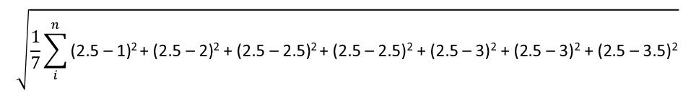
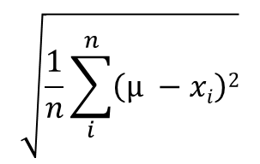

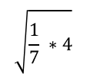
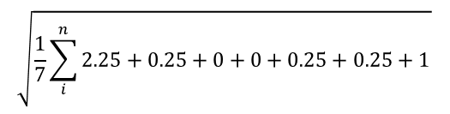
Standard Deviation
The standard deviation is a measure that is used to quantify the amount of variation or dispersion of a set of samples (population).
Symbol for standard deviation (sigma)
$$\sqrt{\frac{1}{n}\sum_{i}^{n}{\left(µ −xi\right)2}}$$
σ =
Sum (add) up the squared difference between the mean and each sample
Divide the summation by the number of samples
Example:
Seven Samples = { 1, 2, 2.5, 2.5, 3, 3, 3.5 } , µ = 2.5
$$\sqrt{\frac{1}{7}\sum_{i}^{n}{\text{(}\text{2}\text{.}\text{5 }\text{– }\text{1}\text{)}\text{2 }\text{+ (}\text{2}\text{.}\text{5 }\text{– }\text{2}\text{)}\text{2} \text{+ (}\text{2}\text{.}\text{5 }\text{– }\text{2}\text{.}\text{5}\text{)}\text{2 }\text{+ (}\text{2}\text{.}\text{5 }\text{– }\text{2}\text{.}\text{5}\text{)}\text{2} \text{+ (}\text{2}\text{.}\text{5 }\text{– }\text{3}\text{)}\text{2} \text{+ (}\text{2}\text{.}\text{5 }\text{– }\text{3}\text{)}\text{2} \text{+ (}\text{2}\text{.}\text{5 }\text{– }\text{3}\text{.}\text{5}\text{)}\text{2 }}}$$
$$\sqrt{\frac{1}{7}\sum_{i}^{n}{\text{2}\text{.}\text{25 }\text{+ }\text{0}\text{.}\text{25 }\text{+ }\text{0 }\text{+ }\text{0 }\text{+ }\text{0}\text{.}\text{25 }\text{+ }\text{0}\text{.}\text{25 }\text{+ }\text{1 }}}$$
$$\sqrt{\frac{1}{7} ∗4}$$
$$\sqrt{\frac{4}{7} }$$
=
=
= 0.87

Slide 7
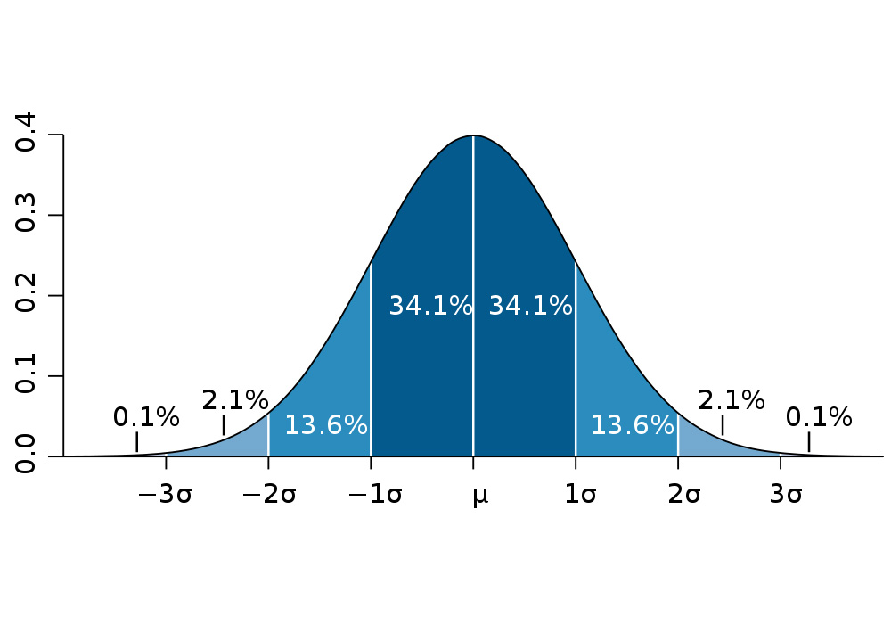
Normal Distribution
The normal (Gaussian) distribution is a distribution that is
used in probability for the expected random distribution of samples
in a population.
Based on distributions on natural occurring things.
68% of the samples should be within 1 standard deviation of the mean.
95% of the samples should be within 2 standard deviations of the mean.
99.8% of the samples should be within 3 standard deviations of the mean.

Slide 8
Population vs. Sample
Can be any distribution
Population
Distribution
µ (mean)
σ (std. dev)
N (size)
Parameters
Random Sample
Probability
x̅ (mean)
s (std. dev) n (size)
Statistic
Can calculate probability of
sample is in population, when
population is known.

Slide 9

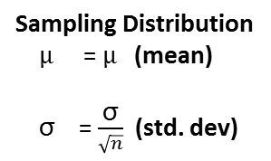
Sampling Distribution
A collection of randomly chosen samples
in a population is called a sampling
distribution.
Population
Sampling Distribution
$µ$ = $µ$ (mean)
σ = $\frac{\text{σ}}{\sqrt{n}}$ (std. dev)
x̅
x̅
x̅
x̅
x̅
Random Samples
( , , , … )
x̅
x̅
x̅
x̅
Plot of Sample Means
Central Limit Theorem
The mean of a sampling distribution will approach the
mean of the population.
Each sample has a mean
As the number of samples increase,
plot of the sample means will approach a normal distribution
Central limit theorem only specifies that the central part of a distribution of averages will approach a normal distribution as the number of trials goes to infinity.

Slide 10
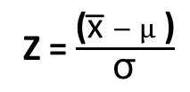

Z-Score
The Z-Score is the same as the standard deviation from the mean
in a normal distribution.
Z-Score = -2
Z-Score = 2
$$µ$$
Arbitrary Z-score (e.g., 1.5)
Z = $\frac{\text{(}\text{x}\text{̅ }− µ\text{ )}}{\text{σ}}$
x̅

Slide 11

Standard Normal Probabilities
The Probability that a Z-Score for a sample will fall within the area of a normal distribution can be looked up in the Standard Normal Probabilities Table - http://www.stat.ufl.edu/~athienit/Tables/Ztable.pdf
50% Probability that Sample falls into the area of the distribution
$$µ$$
Probability of Sample falling within area of distribution increases with the std. deviation

Slide 12

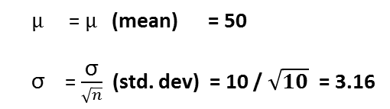

Robot Example
Warehouse of Boxes: Mean Weight of 50 lbs, Standard Deviation of 10 lbs.
Pallet of Boxes: Need to move pallet of 10 boxes of unknown weight.
Robot: Has lift limit of 560 lbs.
Question: What is the probability the Robot can lift this pallet.
Population
Weight Distribution of Boxes
µ (mean) = 50 lbs
σ (std. dev) = 10 lbs
Calculate Std. Dev.
of Pallet
Pallet of 10 Boxes
Weight of Boxes Unknown
$µ$ = $µ$ (mean) = 50
σ = $\frac{\text{σ}}{\sqrt{n}}$ (std. dev) = 10 / $\sqrt{10}$ = 3.16
x̅
x̅
Maximum mean weight of
10 boxes robot can lift.
X̅
_{max} = 560 lbs / 10 boxes = 56
Z = $\frac{\text{(}\text{x}\text{̅}\text{max} − µ\text{ )}}{\text{σ}}$
= $\frac{6}{3.16}$ = 1.9
Standard Normal Probability of 1.9 = 97.13 %
x̅

Slide 13

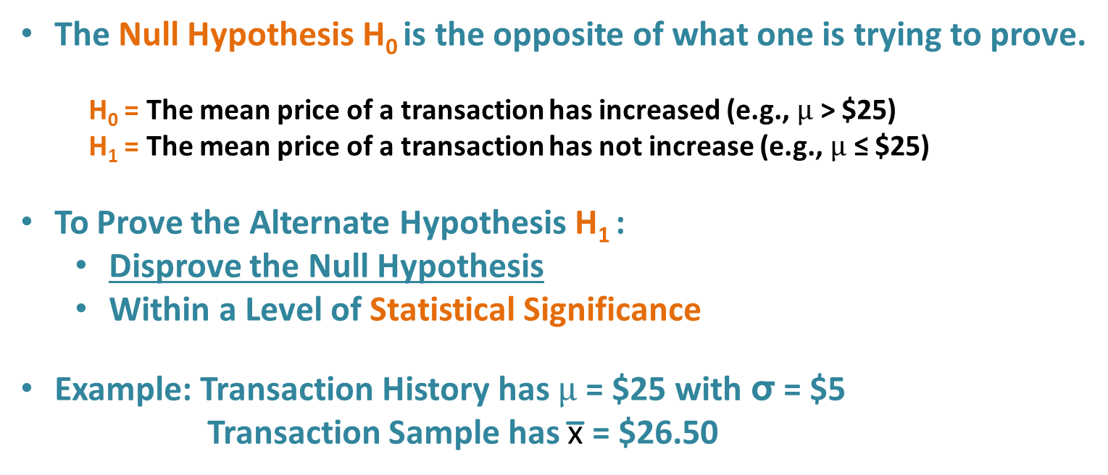



Null Hypothesis
The Null Hypothesis H₀ is the opposite of what one is trying to prove.
H₀ = The mean price of a transaction has increased (e.g., $µ$ > $25)
H₁ = The mean price of a transaction has not increase (e.g., $µ$ ≤ $25)
To Prove the Alternate Hypothesis H₁ :
Disprove the Null Hypothesis
Within a Level of Statistical Significance
Example: Transaction History has $µ$ = $25 with σ = $5
Transaction Sample has $\text{x}\text{̅}$ = $26.50
i.e., nothing changed
Transaction Sample Size = 10
Transaction Sample Size = 100
σ = $\frac{\text{σ}}{\sqrt{n}}$ = 5 / $\sqrt{10}$ = 1.58
σ = $\frac{\text{σ}}{\sqrt{n}}$ = 5 / $\sqrt{100}$ = 0.5
Calculate Std. Dev. of Transaction
x̅
x̅
Z = $\frac{\text{(}\text{x}\text{̅}\text{max} − µ\text{ )}}{\text{σ}}=$ $\frac{26.5 −25}{1.58}$ = 0.95
Z = $\frac{\text{(}\text{x}\text{̅}\text{max} − µ\text{ )}}{\text{σ}}=$ $\frac{26.5 −25}{0.5}$ = 3
Z-Score of Transaction
x̅
x̅
Standard Normal Probability of 0.95 = 82.18 %
Standard Normal Probability of 3 = 99.87 %
Confidence Level

Slide 14
Box (and Whisker) Plot
A method used to visualize the spread of data.
Split the data into quartiles (quarters).
A box is drawn around the middle two quartiles (1st and 3rd)
The whiskers are drawn at the end points.
1. Calculate the median
of the entire dataset,
Split the dataset into halves.
Whisker
Highest value
3rd quartile (median of upper half)
2. Calculate the median
of the top and lower half
of the dataset, splitting them
Into quarters.
Data Values
(x)
Box
(IQR)
2nd quartile (median)
1st quartile (median of lower half)
Whisker
Lowest value
0

Slide 15
Box (and Whisker) Plot - Outliers
A variation of a box plot to show outliers.
The whiskers are replaced with an inner and outer fence at
1.5 x IQR (inner) and 3 x IQR (outer).
Values between 1.5 and 3 IQR are suspected outliers (white).
Values outside of 3 IQR are outliers (black).
Outlier
Outer Fence (3 IQR)
Suspected
Outliers
Inner Fence (1.5 IQR)
Data Values
(x)
Box
(IQR)
Inner Fence (1.5 IQR)
Outlier
0

